Slide 1
Male offspring of undernourished dams are protected from high fat diet-induced weight gain and display sex-specific metabolic changes
Kya Carroll
Hendrix College
Lab of Drs. Gwen Childs and Angela Odle
Assisted by Dr. Tiffany Miles
Notes:
Good Morning
My name is Kya Carroll, and I am a Senior at Hendrix College majoring in Health sciences with a minor in psychology

Slide 2
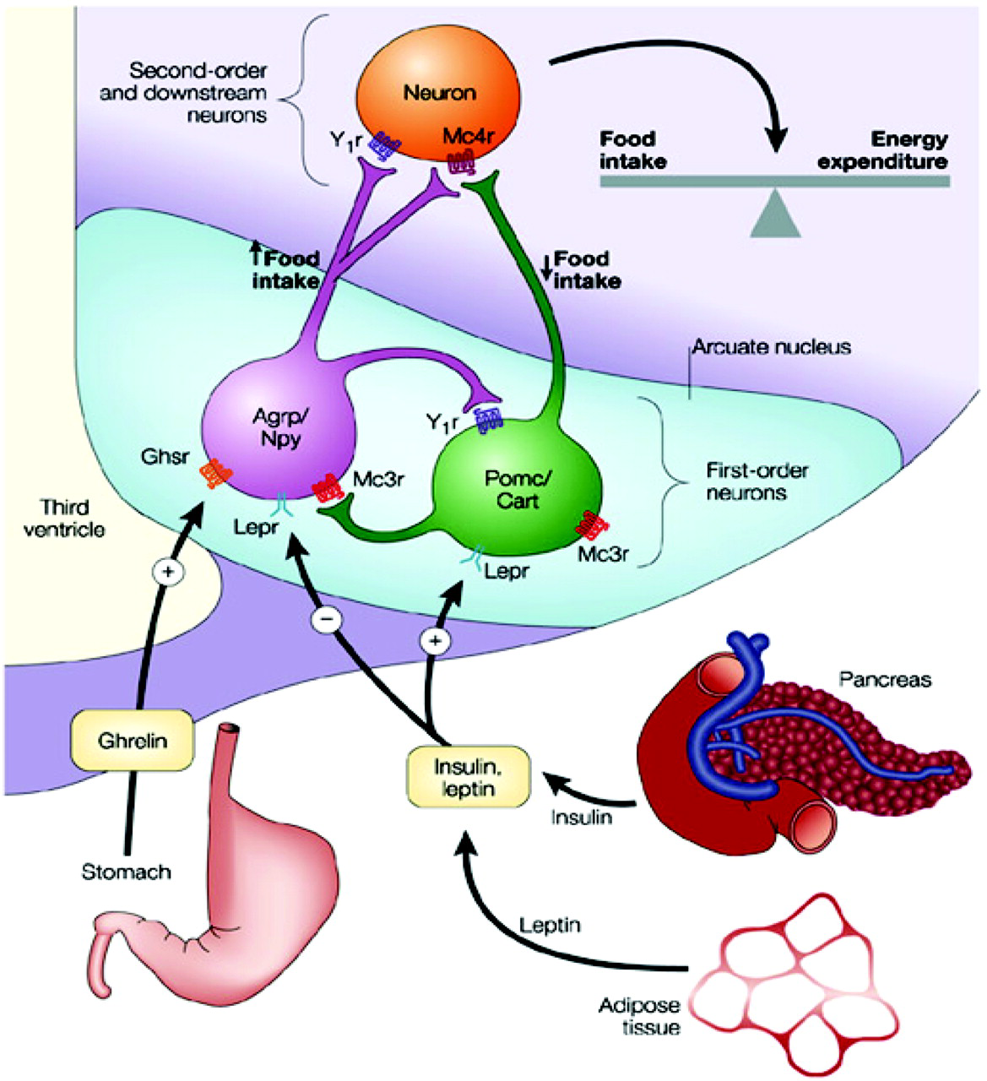
Leptin: Overview
Leptin is a hormone secreted by adipose tissues and acts as an appetite suppressor in the hypothalamus, regulating food intake
Circulating leptin levels are proportional to adipose storage
Increased circulation of leptin is associated with obese individuals, who have higher adiposity
Leptin receptors are also found in the pituitary
Foster-Schubert, K. E., & Cummings, D. E. (2006). Emerging therapeutic strategies for obesity. Endocrine reviews, 27(7), 779-793.
Notes:
Primarily our project is looking at the hormone Leptin is.....
When leptin is binds to Agrp Food intake increases

Slide 3
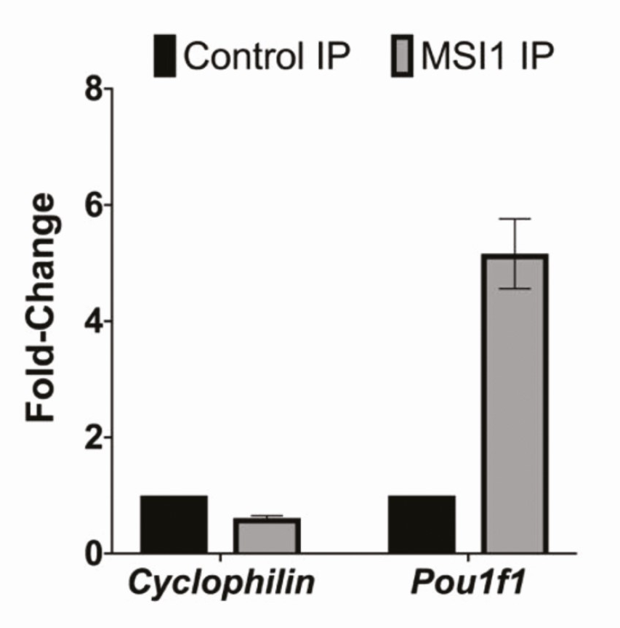
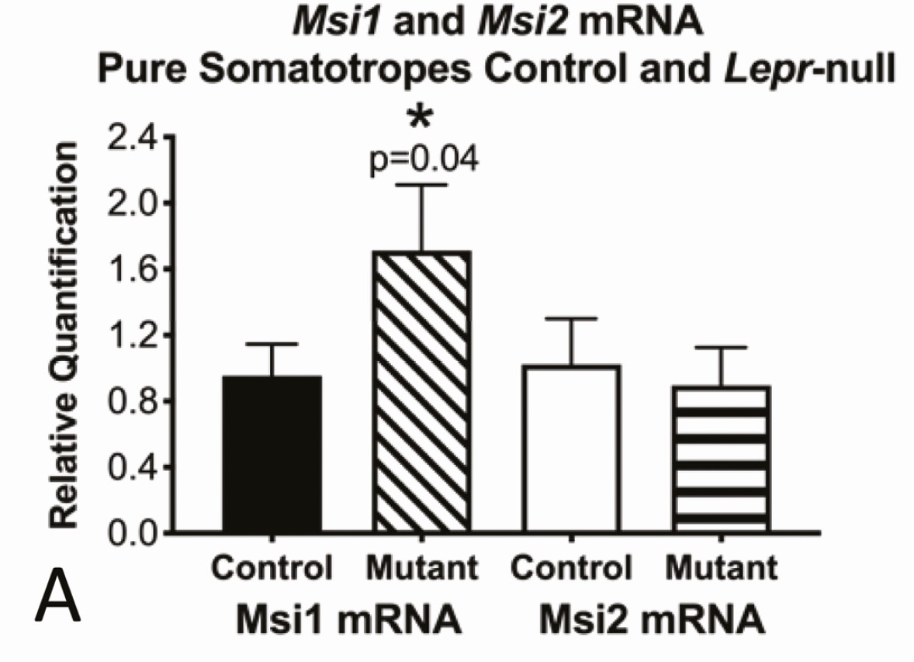
Musashi In The Anterior Pituitary Is Regulated By Leptin Signaling
In mice, where leptin receptor (LEPRnull) is specifically ablated in growth hormone producing cells, Msi1 mRNA is increased
Musashi
RNA binding protein
Two isoforms: MSI1 and MSI2
Translational regulator: prevents or promotes translation of RNA to protein
Translation of Pou1f1, which is necessary for pituitary maturation, is inhibited by MSI
A
B
Figure 2: A) Msi1 transcript increased with loss of leptin signaling. B) Pou1f1 is a target of MSI shown by immunoprecipitation
Source
Allensworth-James, M., Banik, J., Odle, A., Hardy, L., Lagasse, A., Moreira, A.R.S., Bird, J., Thomas, C.L., Avaritt, N., Kharas, M.G. and Lengner, C.J., 2021. Control of the anterior pituitary cell lineage regulator POU1F1 by the stem cell determinant Musashi. Endocrinology, 162(3), p.bqaa245.
Notes:
Through a colllaborator with the macnicke group we saw that Mushasi was altered in leptin receptor somatortrope knockout an RNA binding protein Translation regulator (prevents or promotes transation of RNA into protein)
In this case Musahi will inhibit translation of Pou1f1 a protin necessary for pituritary maturtiion
When leptin receptors are specifically ablated within the pituitary MSi mRNA increases, MSI protein prevention the translation of Pou1f1 which in turn effects pititary maturation

Slide 4
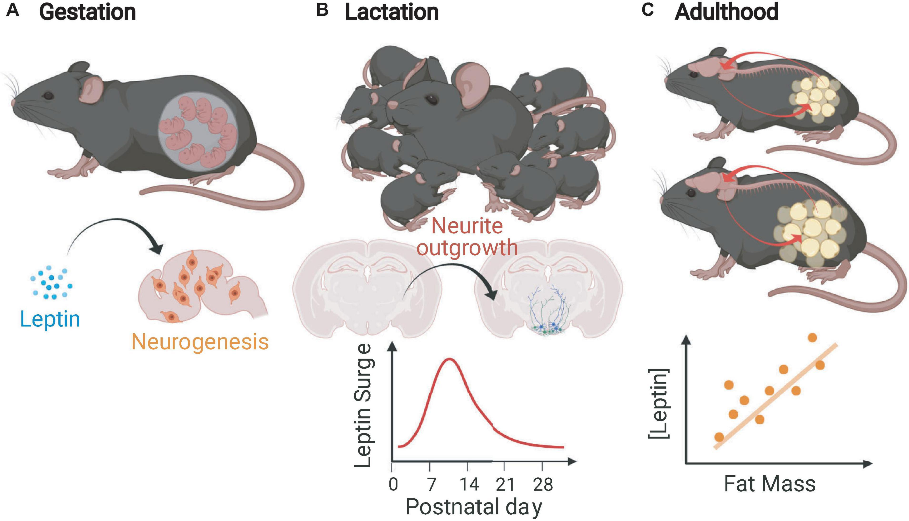
Neonatal Leptin Surge
A surge in leptin is seen within the neonatal development of both rodents and humans
3rd trimester in humans
Postnatally in rodents
Occurs independent of adiposity and prompts development of anorexigenic (appetite suppressant) neurons
Studies suggest that maternal undernutrition alters the levels of the leptin surge, making the surge happen prematurely.
Premature leptin surge led to metabolic dysfunction and weight gain in adult progeny.
Figure 4: Graphs of Neonatal Leptin Surge
Source: https://www.frontiersin.org/articles/10.3389/fphys.2021.789519/full
Notes:
We are interested in this process called the leptin surge and its correlation with pituitary and metabolic dysfucntion
so we know that the timing of the leptin surge is very important
further weight gain

Slide 5
What we want to know…
We will be focusing on altering leptin itself and understanding its affects on pituitary development and metabolic function
Hypothesis: A 30% maternal undernutrition in FVB mice will blunt the neonatal leptin surge and will alter MSI target expression in neonates that will persist in the adult offspring.
Notes:
What I will be specifaally focuesd on this summer is collecting metabolic functioning data on the mice we are studying

Slide 6
(Aug - Nov 2022)
PND21: Pups are weaned and grouped by sex.
9 weeks (age): Pups Start 60% HFD or 10% HFD and continue for 26 wks
36 weeks (age): Glucose Tolerance Test
37 weeks (age): Metabolic Cages (CLAMS)
38 weeks (age): End diet, euthanize and harvest tissues
E(-1) Dams mated in proestrus.
E19 Pups born.
E15 Start 30% caloric restriction pair fed to ad libitum fed dams.
E0: Vaginal plugs determined.
(Apr - Jul 2023)
Mice strain: FVB.129P2-Fmr1tm1Cgr/J, “Sighted FVB”
Part 1: Maternal mice were fed a 30% calorie restricted diet (CR30) to cause a blunted leptin surge in their progeny.
Part 2: These progeny were then fed either a control diet or a high fat diet. Weekly weight gain was assessed along with serum leptin and metabolic functions such as glucose tolerance testing, and metabolic cages in adult progeny.
CR30 Dams = 5
Males CTRL = 6
Female CTRL = 9
Fed Dams = 5
Males CTRL = 8
Female CTRL = 11
Males HFD = 6
Female HFD = 9
Males HFD = 9
Female HFD = 11
Notes:
Experimetal design - we will be using FVB mice for our study
The main approach is
Embrogyenic -1 (Day of mating)
E15 Maternal mice are either fed 30% Calorie restricted diet or a “normal” fed diet (denote them as CR30 or Fed Dams)

Slide 7
Part 1: Moderate (30%) maternal undernutrition in FVB mice blunts neonatal leptin surge and alters Msi and Pou1f1 mRNA
 | Fed | CR30
PND 5 | 10 | 7
PND 8 | 22 | 13
PND 10 | 15 | 12
PND 16 | 18 | 13
TOTAL | 65 | 45
PND 10
Notes:
Figure 1: Weight, leptin levels, and MSI mRNA in pups born from 30% calorie restricted (CR30) dams and Fed dams. A) CR30 pups had less weight gain than Fed pups. B) Blunted leptin surge seen in CR30 pups at PND10. C) Msi1 transcript was unchanged with the undernutrition. D) Msi2 transcript was decreased by 51.5% (-0.5145 ± 0.1222, p=0.0004) and Pou1f1 transcript (E) was decreased by 83.5% (-0.8344 ± 0.1147, p<0.0001) in CR30 offspring. Error bars are SEM. ***p<0.001; ****p<0.0001. Student’s t-test.

Slide 8
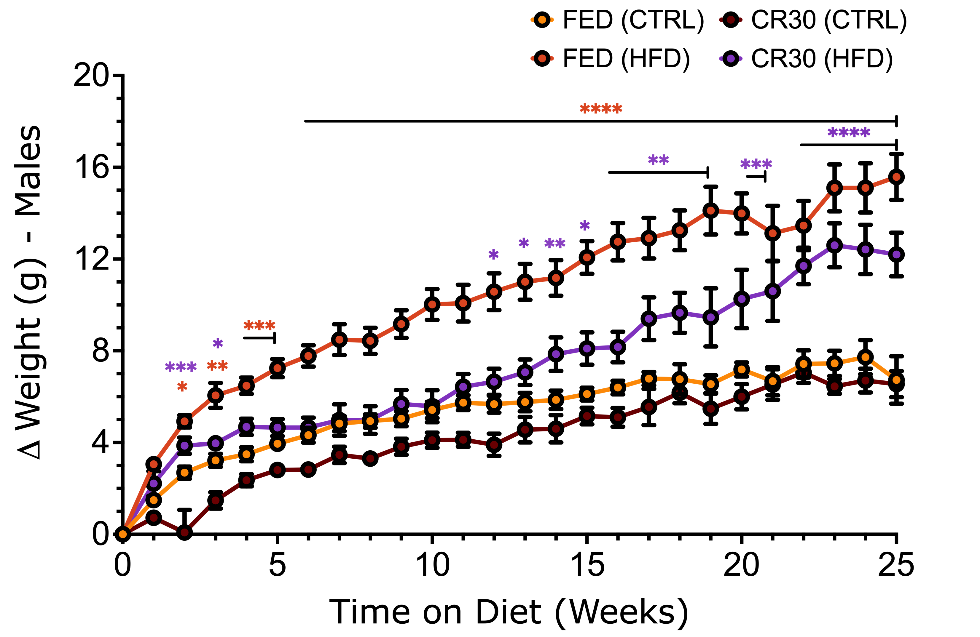
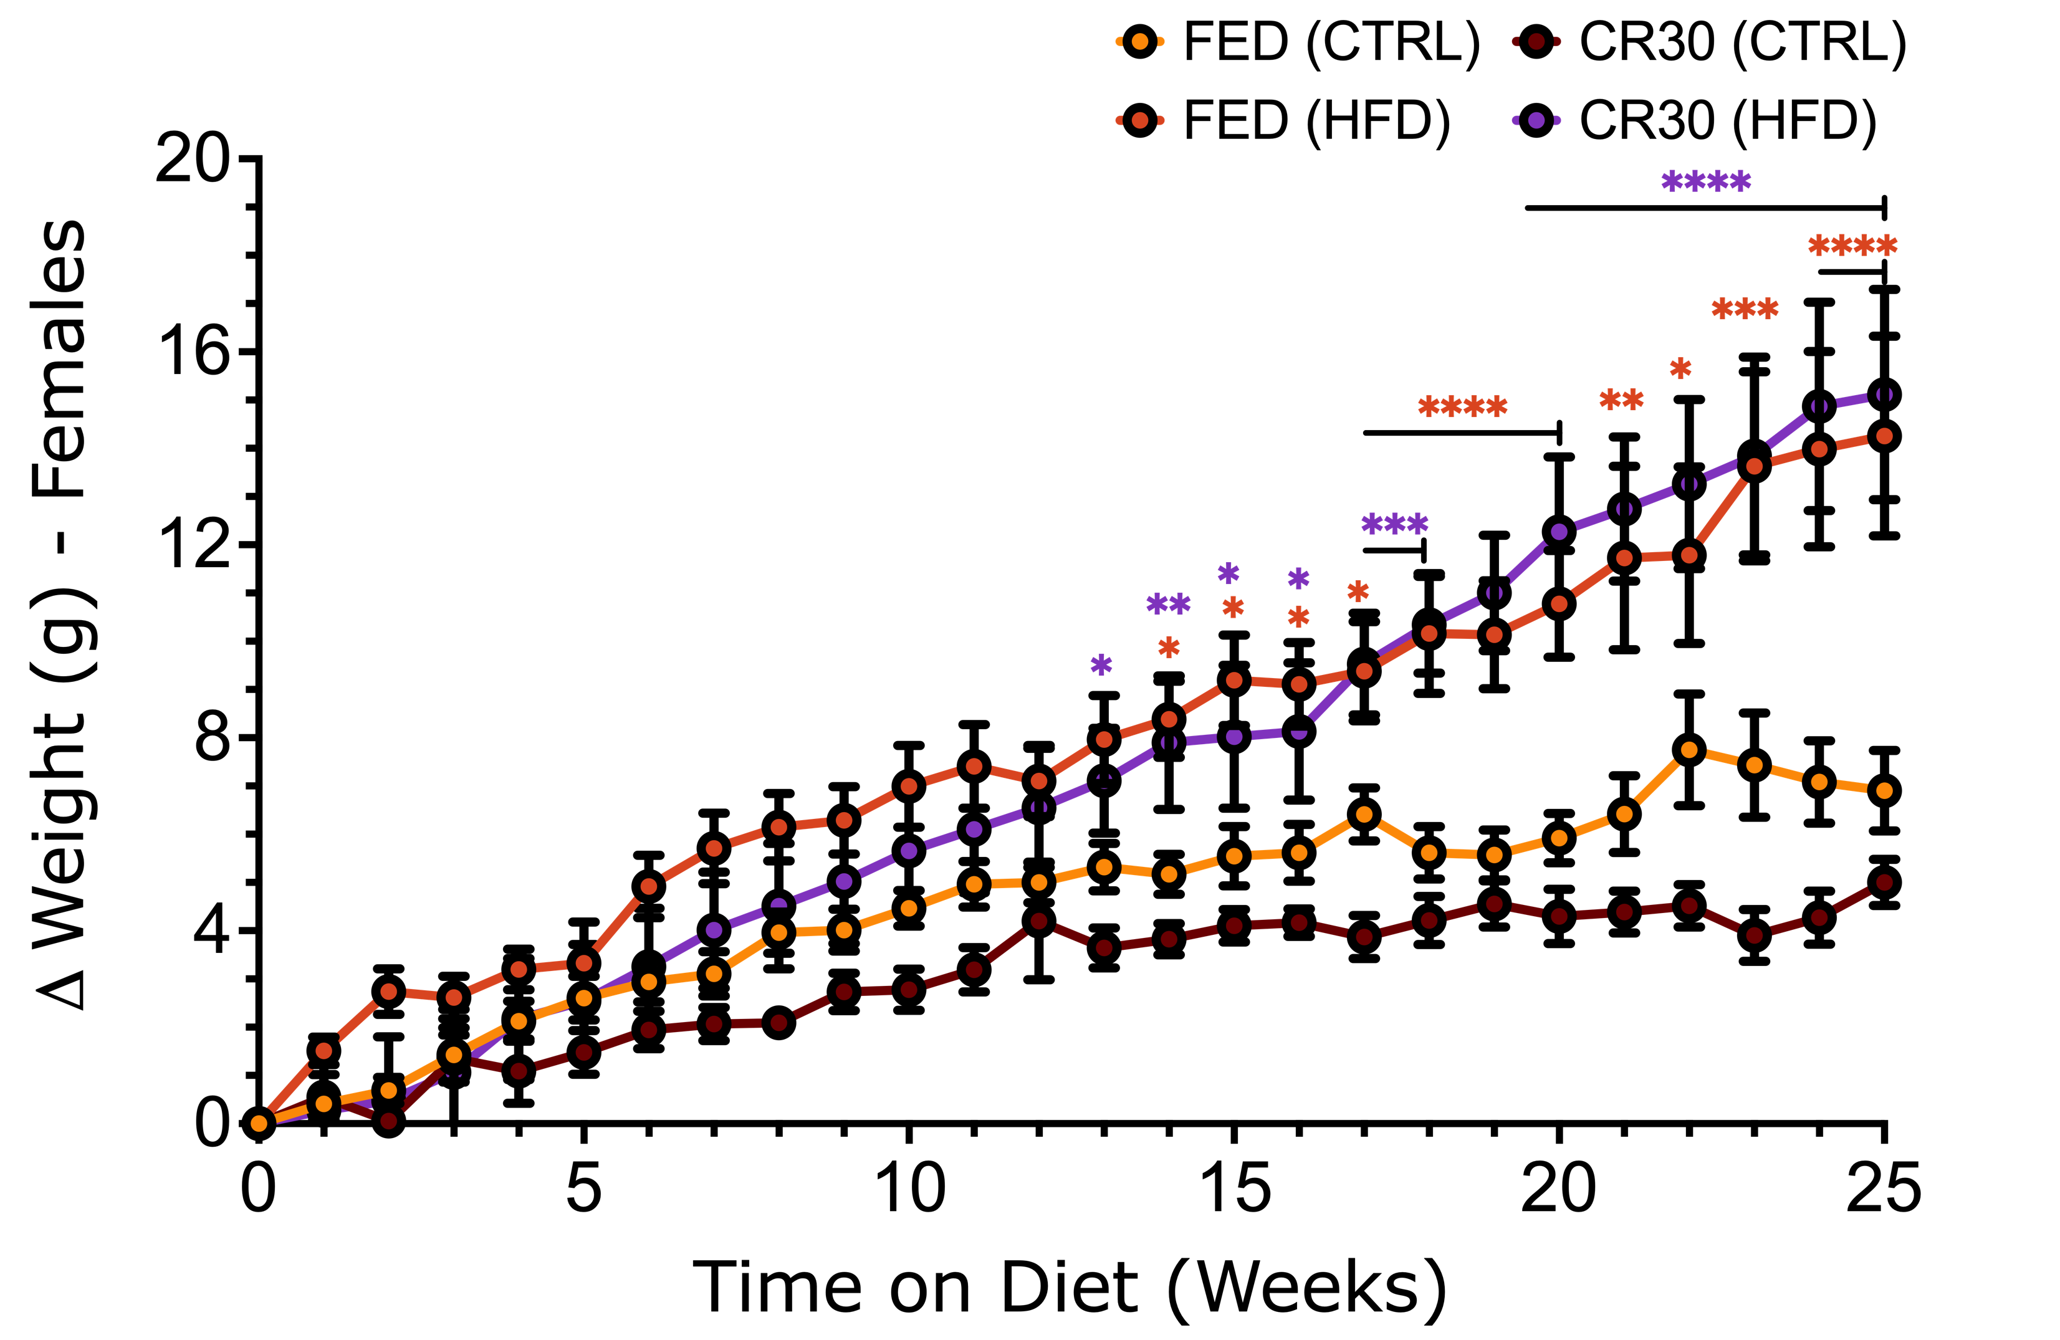
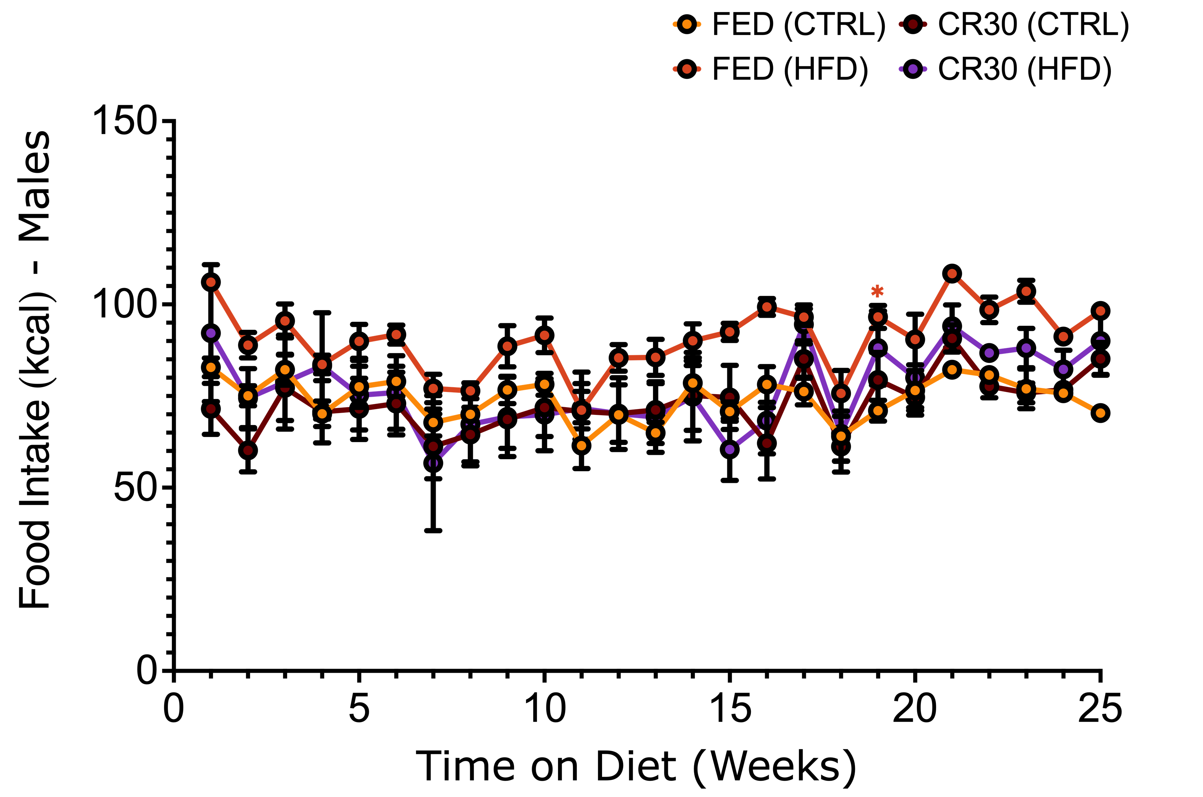
Part 2: CR30 HFD males weekly weight gain was blunted, but not the CR30 HFD females
Notes:
Figure 2: Male and Female adult weights and food intake over 25 wks. A) CR30-HFD males had reduced weight (starting at 5 wks, 3.761g less than CTRL-HFD, p<0.05). B) CR30-HFD females gained more weight than CTRL-HFD. C) CR30-HFD males had reduced food intake compared to Fed-HFD males. D) CR30 females had increased food intake than CTRL-HFD. CR30 HFD males weekly weight gain was blunted, but not the CR30 HFD females. Error Bars are SEM. *p<0.05, **p<0.01, ***p<0.001; ****p<0.0001. Two- Way Anova
So what did we observe
As you can see by the graph what we expected happened in both sexs (mice fed HFD increased in weight) however what is interesting is that the CR30 males was blunted where they weren’t gaining weight as much weight as the FED HFD males and the females continued to gain weght smilaritly in FED and CR30
Food intake was not significantly diff amoung condituons so we can conclulde that it was the compositon of the diet that affected weight gain

Slide 9
Glucose Tolerance Testing
GTT is a metabolic tolerance test used to determine the body’s efficiency of using and storing glucose
Used to diagnose conditions such as insulin resistance and diabetes mellitus
Obesity is a common condition for impaired glucose clearing within the body
GTT Procedure in mice:
Mice are fasted for 6 hrs. prior to testing
A baseline glucose measurement (T0) is taken using a handheld glucometer. A small drop of blood is extracted from the tails of the mice
Injection of glucose is then administered: Volume = 20% glucose stock solution X body weight (g)
Blood glucose is then evaluated every 15-, 30-, 60-, 90-, and 120-minutes post injection.
Notes:
Next we did GTT on the mice to observe Fasting depletes liver glycogen stores and produces a baseline blood glucose levels

Slide 10
Part 2: CR30 HFD males had a reduced spike in glucose levels and clearance compared to CR30 HFD females. Serum leptin trended with weight gain.
MALE
FEMALE
Notes:
Figure 3: Male and Female Adult blood glucose and leptin levels. A) CR30- HFD males had reduced insulin resistance compared to Fed-HFD males. B) In females, insulin resistance was not significantly different between CR30-HFD and Fed-HFD. C) Male CR30-CTRL leptin levels were significantly lower compared to CR30 HFD males. Error Bars are SEM. *p<0.05, **p<0.01, ***p<0.001; ****p<0.0001. Two- Way Anova

Slide 11
CLAMS: Comprehensive Lab Animal Monitoring System
Measures/Calculates
Respiratory Exchange Ratio (RER)
Indicates preferential energy source
Values close to 1.0 = carbohydrates are main energy source
Values closer to 0.7 = fats are main energy source
Energy Expenditure: body heat
Physical Activity: movement on X- and Z- axis
Assessed at thermoneutral temperature

Slide 12
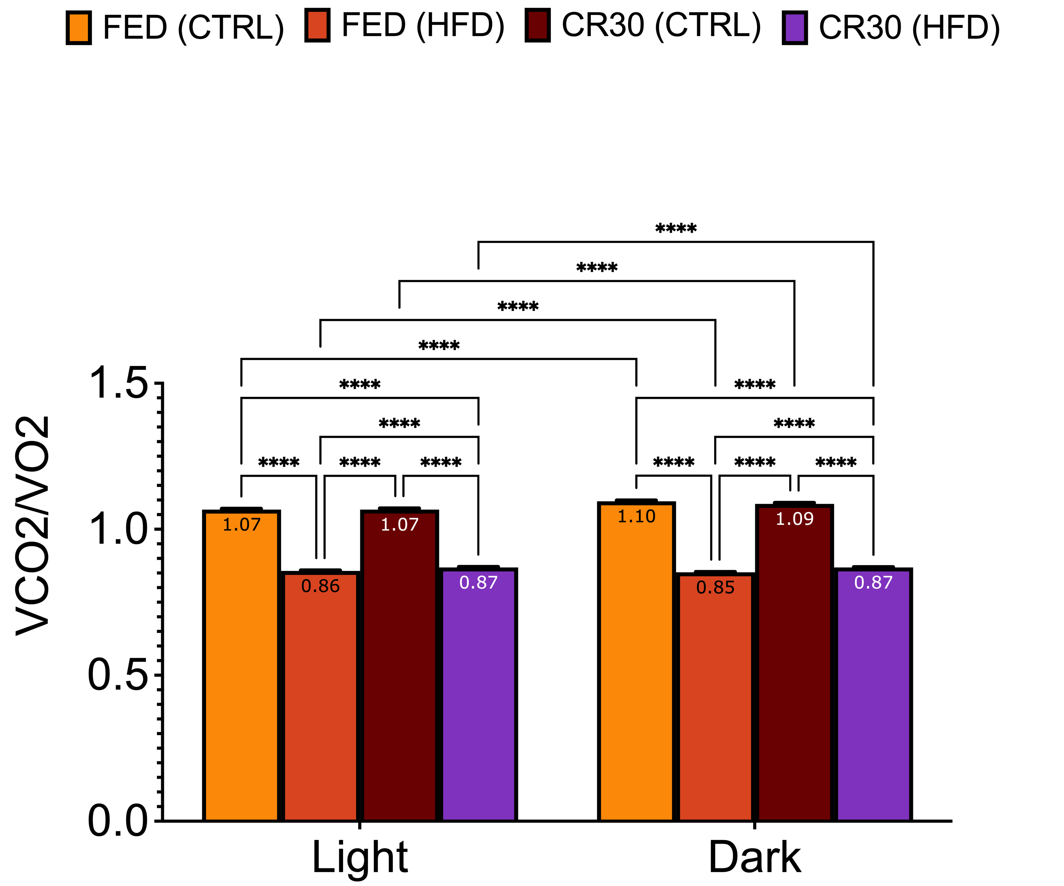
Part 2: RER is reduced (~0.87) in all HFD group, while energy expenditure was increased in all HFD groups except for Fed-HFD females.
MALE
FEMALE
Respiratory Quotient
Energy Expenditure
Notes:
Figure 4: Adult male and female respiratory quotient, energy expenditure, ambulation and grooming, and rearing and jumping data from CLAMS. The respiratory quotient in male (A) and female (B) CR30 offspring was the same as Fed in response to HFD feeding. B). C) CR30-HFD males had reduced energy expenditure compared to Fed-HFD males. D) CR30-HFD females had an increased energy expenditure compared to Fed-HFD. CR30-HFD males had reduced ambulation and grooming compared to Fed-HFD males. Error Bars are SEM. *p<0.05, **p<0.01, ***p<0.001; ****p<0.0001. Two- Way Anova
0.87 reduced in all HFD expeted means more fat was utiilzated compared to carbs
We have published earlier in lab that obese mice had higher energy expenditure

Slide 13
Part 2: Ambulation and Grooming (X-axis) and Rearing and Jumping (Z-axis) movement was reduced among CR30-HFD groups
MALE
FEMALE
Ambulation and Grooming
Among Fed-HFD group, males had reduced movement along X-axis, and not females
X- and Z-axis movement was increased in CR30-CTRL females during the dark phase
Rearing and Jumping
Notes:
Figure 4: Adult male and female respiratory quotient, energy expenditure, ambulation and grooming, and rearing and jumping data from CLAMS. The respiratory quotient in male (A) and female (B) CR30 offspring was the same as Fed in response to HFD feeding. B). C) CR30-HFD males had reduced energy expenditure compared to Fed-HFD males. D) CR30-HFD females had an increased energy expenditure compared to Fed-HFD. CR30-HFD males had reduced ambulation and grooming compared to Fed-HFD males. Error Bars are SEM. *p<0.05, **p<0.01, ***p<0.001; ****p<0.0001. Two- Way Anova

Slide 14
Conclusions
 | Expected | Experimental Conclusions
Weight | HFD group from maternal undernourished dams gain more weight on the HFD compared to Fed-HFD groups. (Thrifty Phenotype Hypothesis) | CR30 adult males did not gain as much weight on HFD compared to Fed-HFD males, whereas females were not protected from HFD weight gain.
GTT | HFD fed mice produce higher glucose spikes in response to injection and take longer to metabolize and clear glucose from the blood. | CR30 males appear to have a reduced glucose curve compared to Fed-HFD males, suggesting increased insulin sensitivity as a result of slower weight gain compared to Fed-HFD
CLAMS | Trends in RER and EE match previous studies in obese FVB mice. | CR30-CTRL have reduced mobility and further reduced mobility with HFD. This is an unexpected result since reduced mobility would promote weight gain (as seen in females) but does not account for slower weight gain in males.
These experiments have further characterized the phenotype.
Now, mechanistic data is needed!
Notes:
so there is evidence to suggesest some interaction with male mice having undernurished mothers that makes them semingly healthier individuals.
Thrifty phenotype

Slide 15
Next Steps
Proteo-genomics of MSI targets in neonates and adults to determine the effect of this maternal undernutrition model (blunted neonatal leptin surge) on MSI action in the pituitary.
Notes:
RER = C02/02 – ratio of CO2 to O2
ll
EE is measured through heat
Physical acticity is measued through beams where mice will hit laser beams and it detects activity
Long periods of inactivity is recorded as sleep
Food intake recorded by a scale (+/- system)

Slide 16
Thank You & Questions
University of Arkansas for Medical Sciences
Dr. Gwen Childs
Dr. Angela Odle
Dr. Tiffany Miles
Alex Lagasse
Summer Undergraduate Research Program (SURP) to Increase Diversity in Research
Dr. Latrina Prince
Funding
Arkansas Children’s Research Institute and the Arkansas Biosciences Institute: ABIPG4394
2018-2023: R01HD093461 (AM, GC, MM)
2017-2023: R01DK113776 (GC, MM, AM)
2022-2025: 5 R01 DK127723 (GC, MM, AM)
NCATS TRI: UL1 TR003107 and TL1 TR003109

